Slide 1
DSI GROUP - Project 2
By: Jude Darren
Tan Kar Gim
Andrea Wong

Slide 2
TABLE OF CONTENTS
01
02
03
Problem Statement
Methodology
Data Preparation
04
05
06
Modelling
Exploratory Data Analysis (EDA)
Recommendations & Conclusion

Slide 3
Problem Statement
Our real estate agency in Ames, Iowa, is working on a solution to help our in-house real estate agents in comparative market analysis to determine a fair and competitive offering price. With our model, we plan to support our in-house real estate agents in the following areas:
offer proprietary estimate of a property’s value based on the key features of the property
a useful reference point in assessing the fairness of a home’s price

Slide 4
Methodology
Define Objectives
Define the problem to be solved and create a clear objective
Collect, Prepare & Manipulate data
Collect and prepare the data to be used for modelling
Data Exploration & Analysis
Find significant patterns and trends using statistical methods and visualisations
Modelling
Build, fit and validate model
Model Optimization
Assessing model performance and make changes to improve model

Slide 5
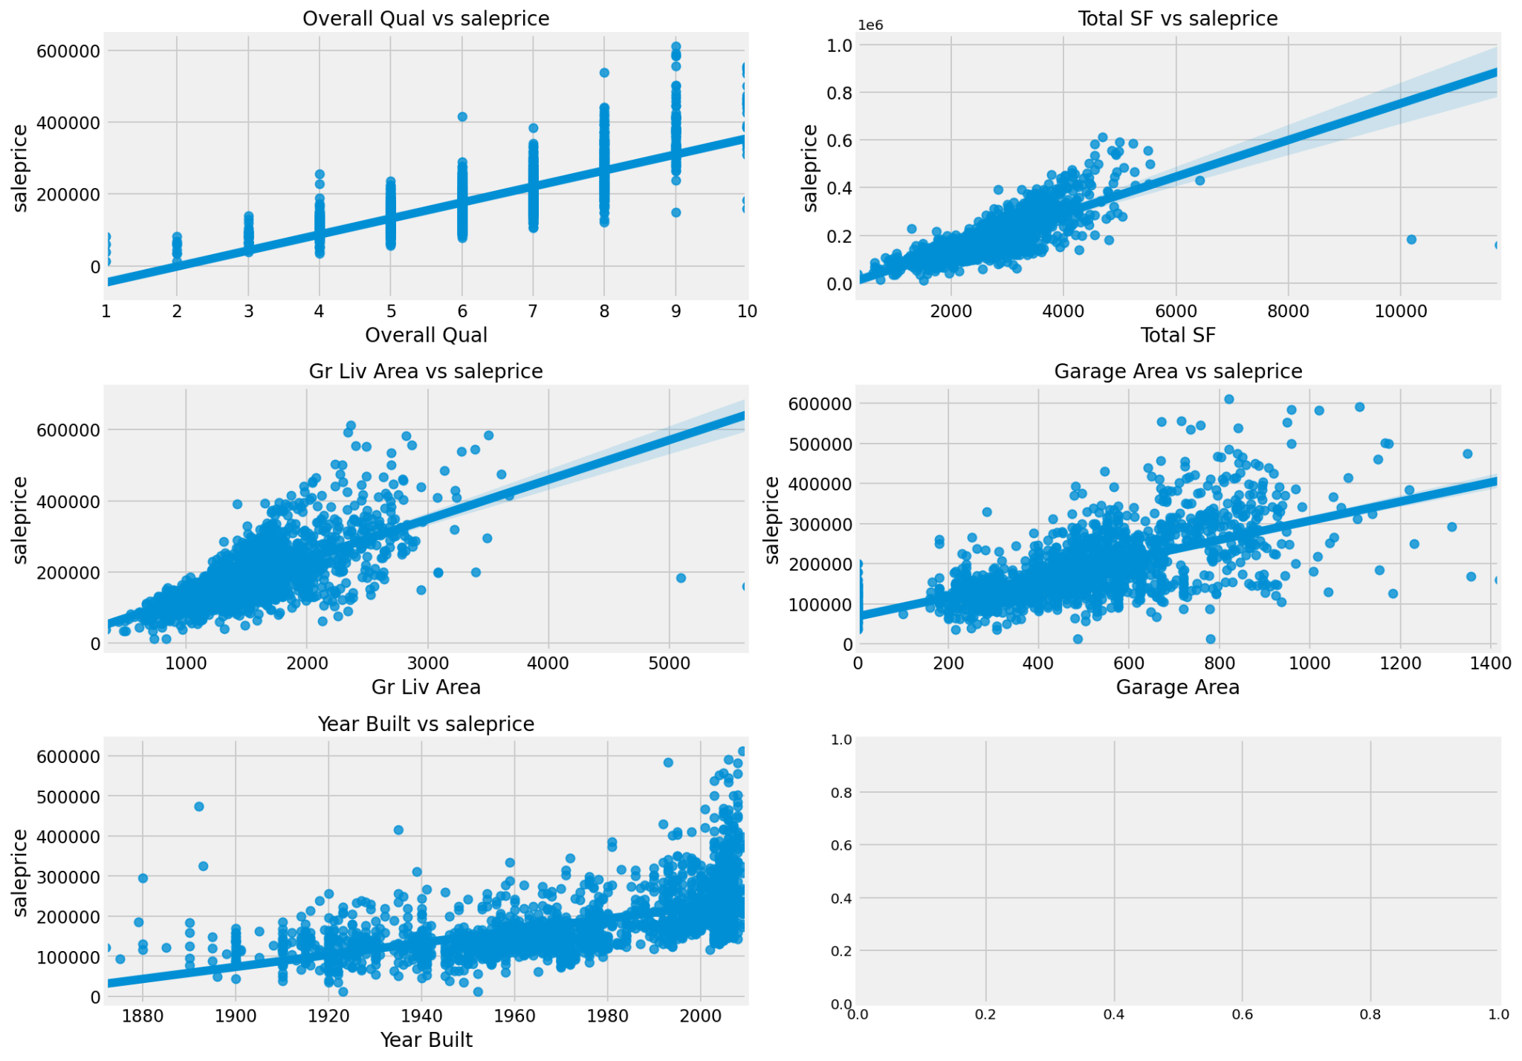

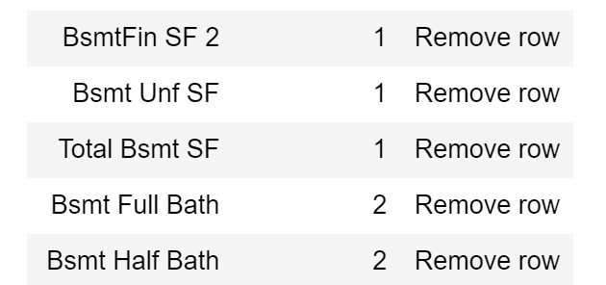
Data Preparation
Outliers
Gr Liv Area > 5000
Total SF > 10000
Removal of Rows
0.15% of samples have incomplete data. Rows with 1 or 2 missing values will removed

Slide 6
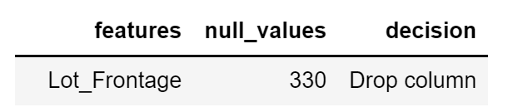
Data Preparation
Remove Columns
Lot Frontage - 16.1% missing
Kitchen Qual_Gd | Kitchen Qual_TA | Kitchen Qual_Fa | Kitchen Qual_Ex
1 | 0 | 0 | 0
0 | 1 | 0 | 0
0 | 0 | 0 | 1
1 | 0 | 0 | 0
Kitchen Qual
Gd
TA
Fa
Ex
One-hot encoding
Categorical variables will be hot encoded before modelling

Slide 7
EDA - Dataset breakdown
Histograms
show the no of observations in each category
Skew of data
01
Categorical Features (52.5%)
Represented as ‘strings’ or ‘categories’ and are finite in number
Boxplots
Visualize the distribution of data through quartiles
02
Housing Dataset
80 features characteristics of a property
Heatmap
Shows multicollinearity between features through colour
03
Numerical
Features (47.5%)
Integers and floats are the most common and widely used numeric data types.
Scatterplot
Plotting of data points on a horizontal and a vertical axis show relationships between two numeric variables
04

Slide 8
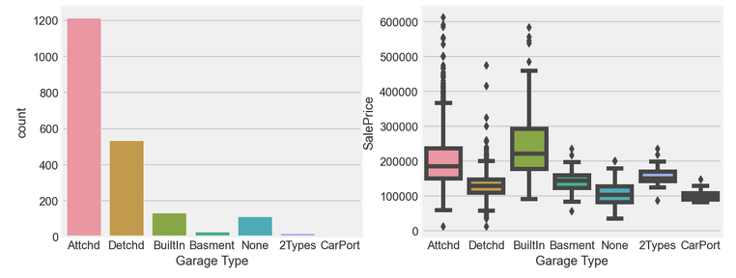
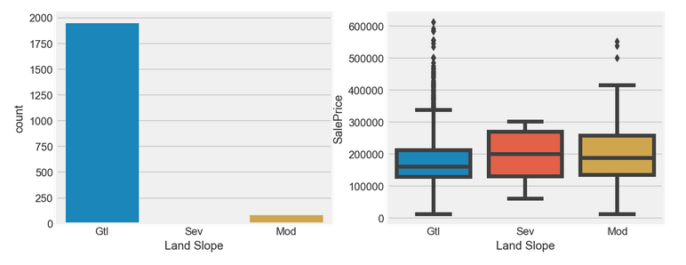
Which categorical features will be useful?
Which categorical features will be useful?
Useful Feature
Less Useful Feature
Key properties of useful categorical features:
High variance
Significant difference median

Slide 9
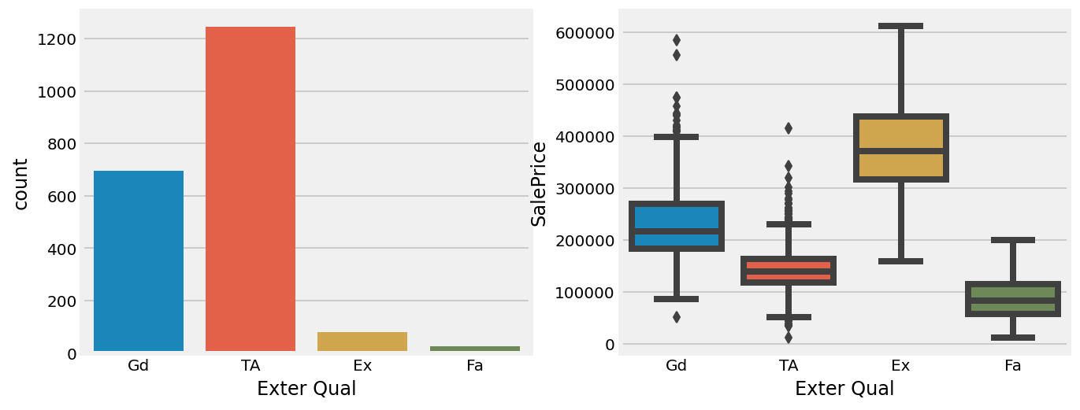
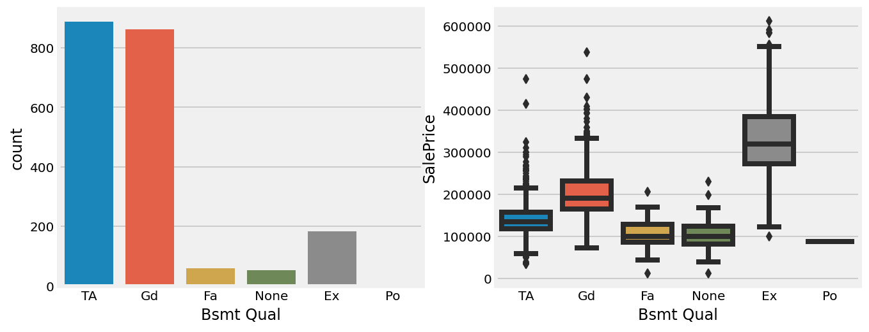
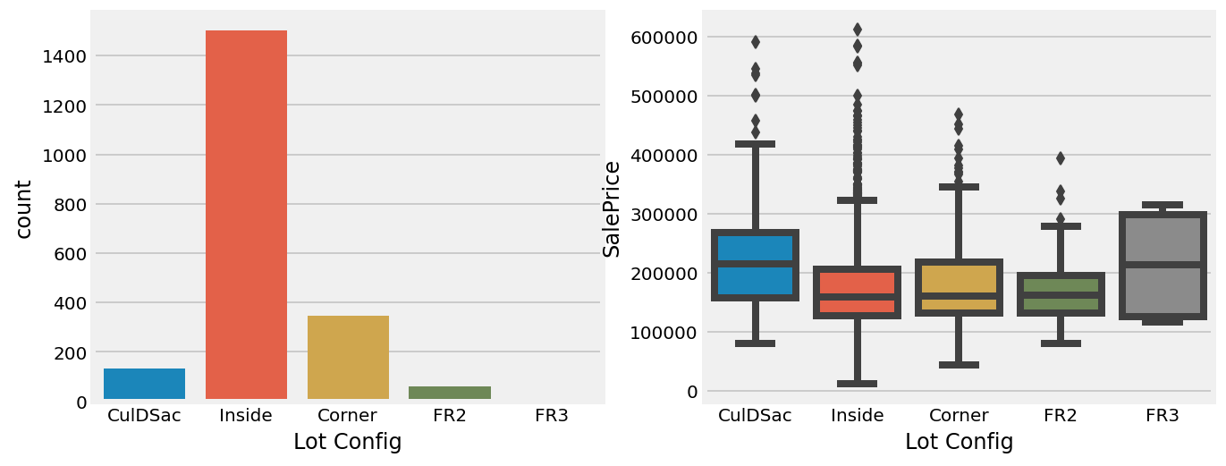
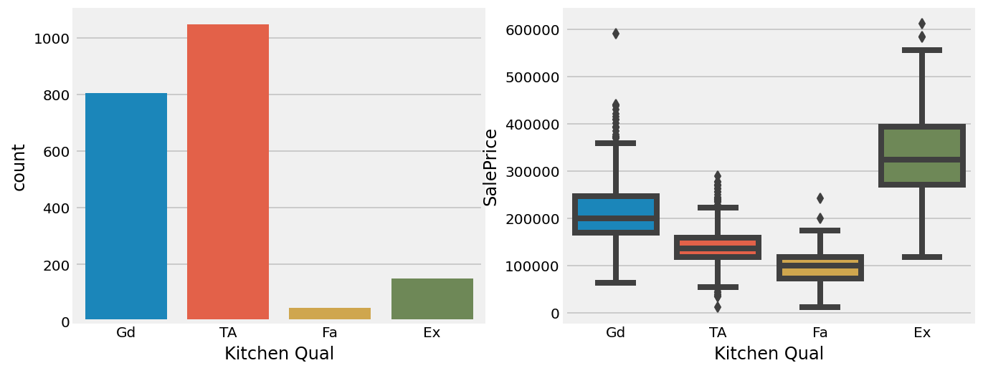
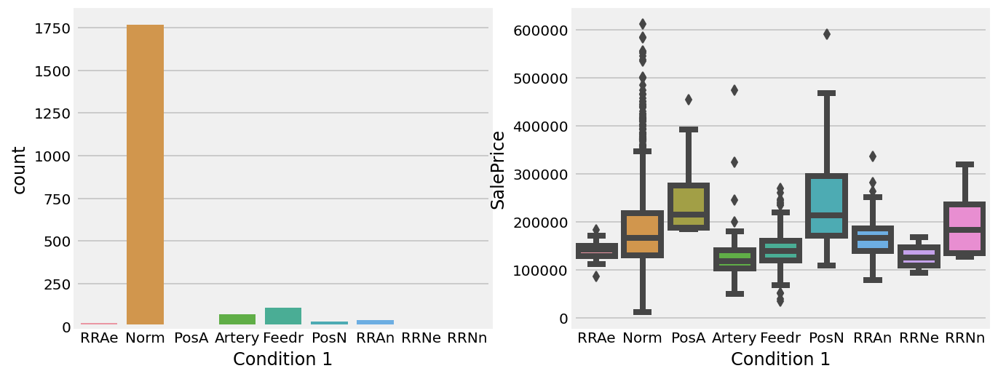
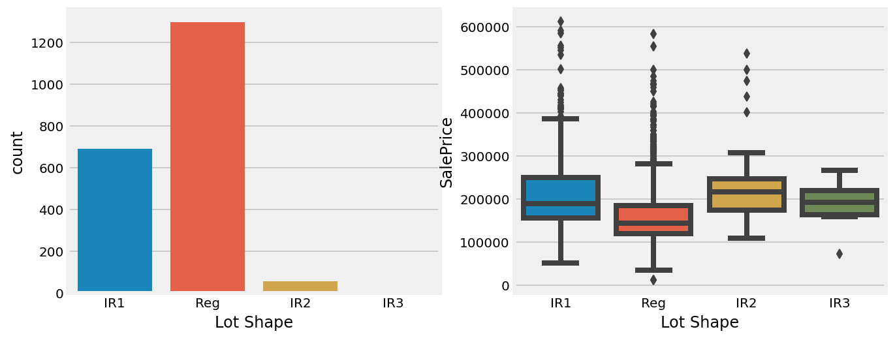
Which categorical features will be useful?
Useful Feature
Less Useful Feature

Slide 10
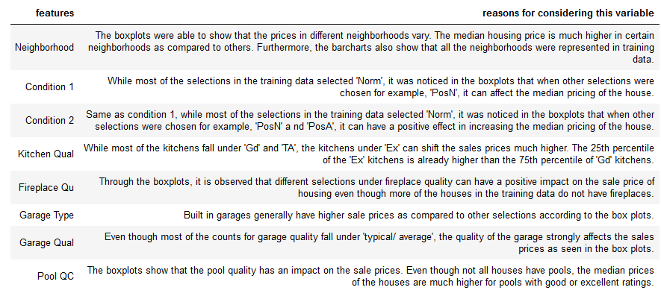
Categorical features considered -initial observations

Slide 11
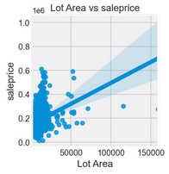
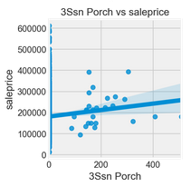
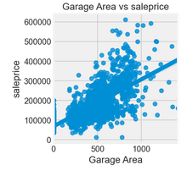
Which numeric features will be useful?
Useful Feature
Useful Feature (With Outlier)
Not Useful Feature
Key properties of useful numeric features:
Highly linear
No outliers (Linear models are sensitive to outliers)

Slide 12
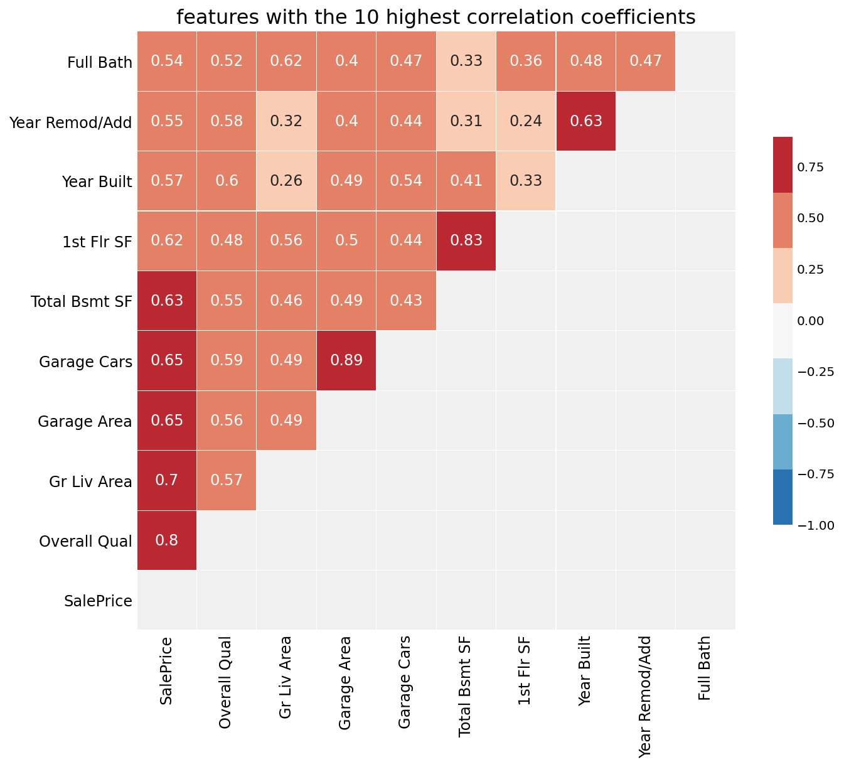
EDA - Multicollinearity
Occurrence of high intercorrelations is observed among two or more independent variables
Year remod/Add & Year Built
1st Flr SF & Total Bsmt SF
Garage Cars & Garage Area
Multicollinearity generates high variance of the estimated coefficients and hence, the coefficient estimates corresponding to those interrelated explanatory variables will not be accurate in giving us the actual picture. They can become very sensitive to small changes in the model.

Slide 13
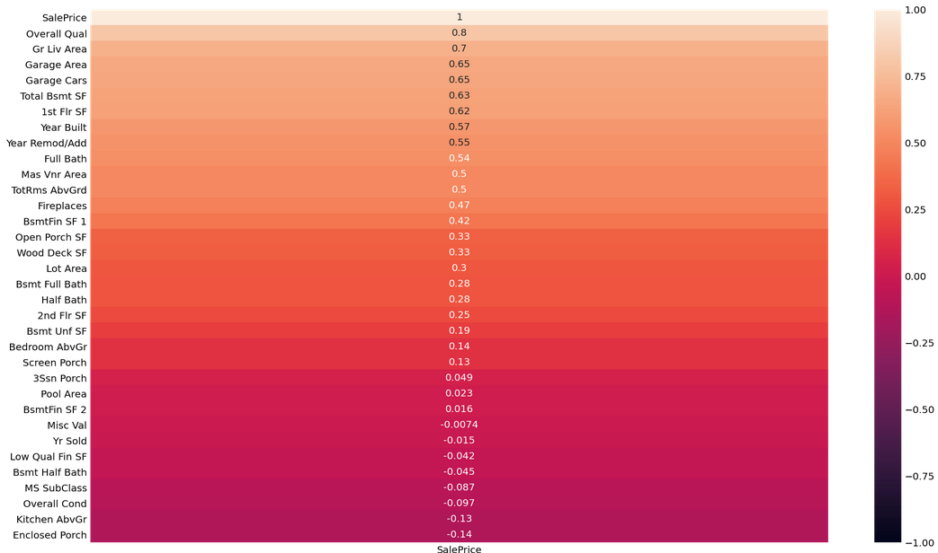
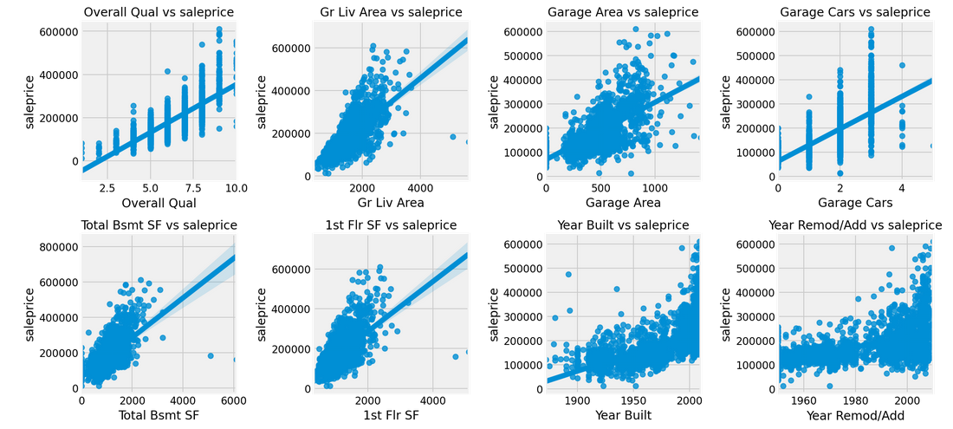
EDA - Feature Engineering (Initial)
Top 5 Features (correlation with SalePrice) :
Overall Qual
Gr Liv Area
Garage Area
Garage Cars
Total Bsmt SF

Slide 14
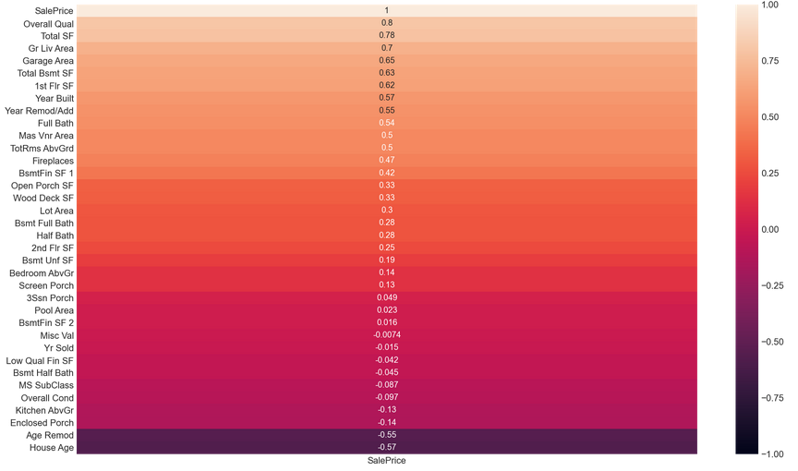
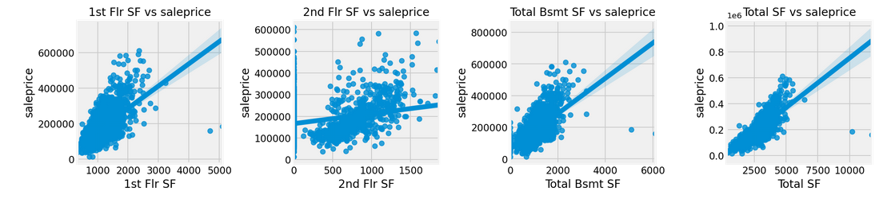
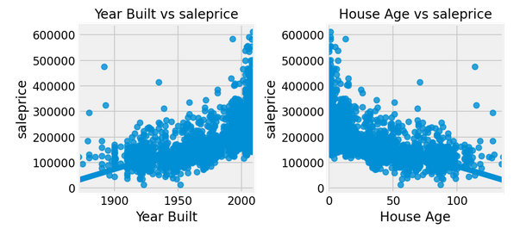
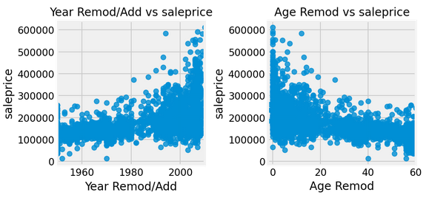
EDA - Feature Engineering
Transformed Columns with multicollinearity
Total SF = Total Basement SF + 1st Floor SF + 2nd Floor SF
House Age = Year Sold - Year Built
Age Remod = Year Sold - Year Remodelled/Add
Before
After
Correlation improved!!!
No improvement in correlation :(
No improvement in correlation :(

Slide 15
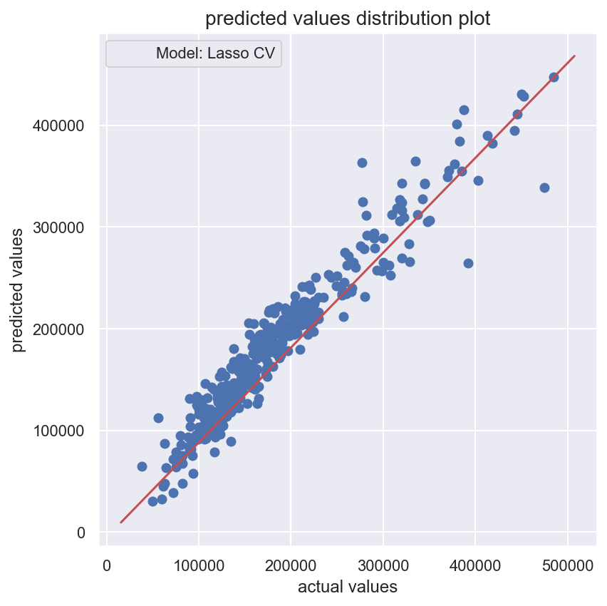
Initial Modelling
Train-test split (Test size = 0.2)
Features with low variance were removed for dimensionality reduction as a feature with low variance cannot explain much of the variance in Sale Price
 | Linear Regression | RidgeCV | LassoCV
RMSE | 22,387.65 | 21,773.30 | 21,320.51
R² | 0.918 | 0.923 | 0.926
Conclusion
The Lasso Regression Model was the best model to test my training data because it was able to manage well unknown data according to the 𝑅2 score. The scatter plot of the predicted saleprice and actual sale price has a generally strong linear relationship except for two outliers.

Slide 16
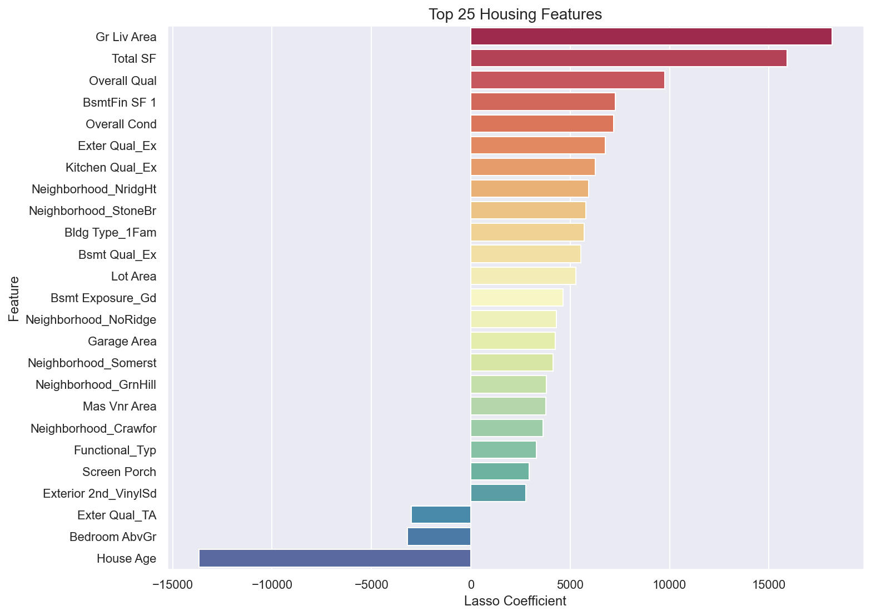
Top 25 features - LassoCV Model
The top features fall under these key categories
Square feet
Quality /Condition
Building Type
Location
Exterior Features
House Amenities

Slide 17
Model Tuning & Optimization
Improved the model through the following methods
Hyperparameter tuning - Adjusted the alpha to the optimal alpha and adjusted max_iter
Top 25 features identified within the lasso model was used to rerun the model
 | Initial LassoCV | LassoCV Hyperparameter tuning | LassoCV Top 25 features
RMSE | 21,320.51 | 21317.64 | 21554.33
R² | 0.9257389 | 0.9257590 | 0.9241011

Slide 18
Recommendations
Sellers
Government
Identify key features to upgrade to obtain a higher selling price.
Monitor market price for properties to identify specific trends in home ownership impacted by sales price.
Buyers
Bank
Sellers to review the sales price and features if present to offer a fair value.
Provide a fair value basis on specific features of the home against market value for borrowers

Slide 19
Recommendations
Developers
Investors
Optimize new development timing, identify specific features which may allow price segmentation and buyer profile to maximize value
Optimize their holdings and regularly assess conditions that lead them to divest or capture value
Property Agents
Construction
Allows greater visibility in terms of price and features and allow them to manage customer expectations in terms of fair price and future trends.
Increase product portfolio which requires the manpower and materials required upgrading to specific features

Slide 20
References
Cock, Dean. “AmesHousing.txt” JSE
http://jse.amstat.org/v19n3/decock/DataDocumentation.txt
How big data is transforming real estate analytics
https://www.mckinsey.com/industries/real-estate/our-insights/getting-ahead-of-the-market-how-big-data-is-transforming-real-estate

Slide 21
Questions?

Slide 22
Conclusion
The lasso model was the best performing model in terms of RMSE, R2.
The key features that are most important in predicting sale prices s are affecting the house prices:
Square feet Area
Condition
Age
Location

Slide 23
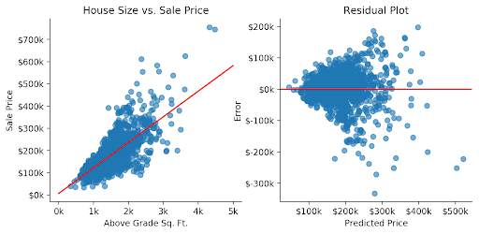
Modelling
Evaluate Regression Model
- train-test split
- cross-validation / grid searching for hyperparameters
- strong exploratory data analysis to question correlation and relationship across predictive variables

